Slide 1
[ASPeKT]
a lightweight AOP foundation
Notes:
ASPeKT is the C# aop library I fathered. When I told my parents that I fathered a library in .NET. They sat me down and said “Son – it’s not that we’re not proud you fathered a library in .NET. We are. When you told us you fathered something… It’s just not what we were expectin.” ☺

Slide 2
Overview
A (quick) look at me
A (quick) look at AOP
A (quick) look at [ASPeKT]
A case study
Questions?

Slide 3
About Me
Peter Lorimer
Almost 30!
Software scientist
Outdoor idealist
Tacoma owner
Notes:
My name is Peter Lorimer, I am almost 30! Graduated in 2011 with a B.Sc. in Computing Science and I’ve been developing software professionally in C++ for about 7 years. I’ve been putting fingers to keys since I was about 12. Recently dove into the dark arts of .NET.
I’m a fitness enthusiast and an outdoor idealist, mostly I like the idea of the outdoors more than I like the outdoors itself. I love to cook anything and everything. So in summary, I like long walks on the beach, cooking candle lit dinners and writing as much code as I possibly can.

Slide 4

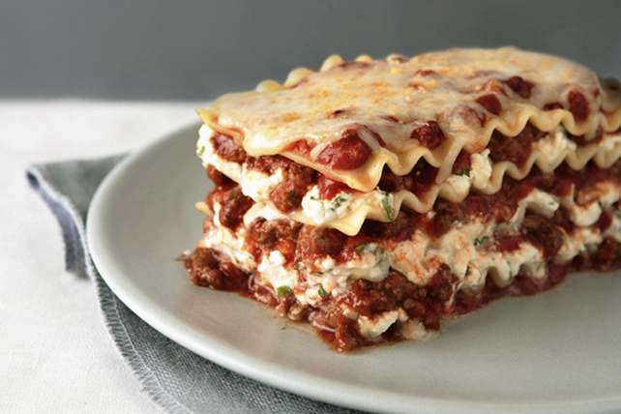
What is AOP?
Notes:
So when I think about AOP this picture basically sums it up for me. We all want our code to be like lasagna, nicely layered, no funny smells, just dry enough. But what often happens is we architect something along those lines and we end up with the picture on the right and end up with the right. Why? Well it could be bad architecture, but it could also be a symptom, a symptom of a lot of cross cutting concerns.
AOP is programming paradigm that helps to deal with cross cutting concerns, allowing for abstraction and encapsulation of this functionality. It is often declarative, removing the necessity for the concerns to be directly embedded in the business logic. This reduces clutter and noise and allows the intent to be much more easily understood.

Slide 5
Benefits of AOP
Modularize functionality
Declutter code
Reduce signal-to-noise ratio
Notes:
DRY

Slide 6
Components of AOP
Cross Cutting Concerns
Logging
Auditing
Code contracts
Error handling
Advice
Join Point
Point-cut
Aspect
Notes:
A cross cutting concern or tangling code, is common code that is scattered throughout unrelated functions. A good programming practice is separation of concerns, ensuring that classes and functions have a specific focus and job. However, there are concerns, functionality in code that becomes viral and spreads throughout a code base. Given a well designed system, respecting SoC, when functionality needs to be altered it may only need to be altered in a given module. However, with a cross cutting concerns, a change can often mean code changes across the entire system.
Advice is additional behaviour we want to apply to the existing functionality
Join Point is the point where we want to apply the new functionality
Point-Cut is pattern or detection algorithm that matches a join point
Aspect is the encapsulation of advice & point-cut

Slide 7
An AOP Model
As per Wikipedia a Join Point Model is defined by 3 things
When the Advice can run
A way to specify Join Points
A means of specifying code to run at the Join Point

Slide 8
Approaches to AOP
Source processing i.e. Source weaving
Runtime interpretation i.e. Run-time weaving
Post processing i.e. Compile-time weaving
Combination
Notes:
Compile time weaving ASPeKT & PostSharp, Runtime weaving .NET Web API foundation(I think), Source Processing (C++ Cfront)

Slide 9
A background on [ASPeKT]
Light weight
Basic
MIT Licensed
Notes:
ASPeKT was conceptualized on a trip I was on with my parents last summer in Vienna and Slovakia. I spent most of my 3 week trip in Europe reading Adaptive Code via C# by Gary McLean Hall and programming in cafes and bars. Drinking beer and writing code are probably my two favourite things on vacation. As an aside, the name ASPeKT is just English Aspect translated to Slovakian. Real creative.
There was a chapter on AOP that I found interesting, but at the time I was interested in solving a different problem. Exception translation. I wanted a way to easily translate an Exception of type A to type B. The use case was along the lines of “what if you have some well known exception from a library, and you want to translate that into my own well known exception?” To be honest, I have no idea why this was the problem I was solving at the time, but it was. Anyways – I hit the section on AOP and I thought to myself “Aha! That’s how I do it. I’ll write an AOP library to do the translation” I did some research into the different approaches and settled on using Mono.Cecil to do my weaving at compile time. It took me a couple days and I had a rough foundation I could use, then a couple more days and I had my silly exception translation.
Now – I’m generally the type of guy that once I’ve solved the problem I want to solve. I just let the code rot somewhere on GitHub or my harddrive. Never to see the light of day again, until one day I run into the problem and I remember how I solved it eons ago. That was what ASPeKT was destined for.

Slide 10
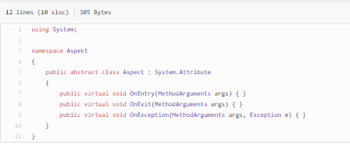
[ASPeKT] Aspect Foundation

Slide 11
Creating an Aspect
class ConsoleLogged : Aspect
{
public override void OnEntry(MethodArguments args)
{
Console.WriteLine("Entering " + args.FormattedName);
}
public override void OnExit(MethodArguments args)
{
Console.WriteLine("Exiting " + args.FormattedName);
}
}

Slide 12
Using an Aspect
class Program
{
[ConsoleLogAspect]
static void LogMe(int a, string b, bool c)
{
Console.WriteLine("I was logged");
}
static void Main(string[] args)
{
LogMe(10,"Hello World", true);
Console.ReadKey();
}
}

Slide 13
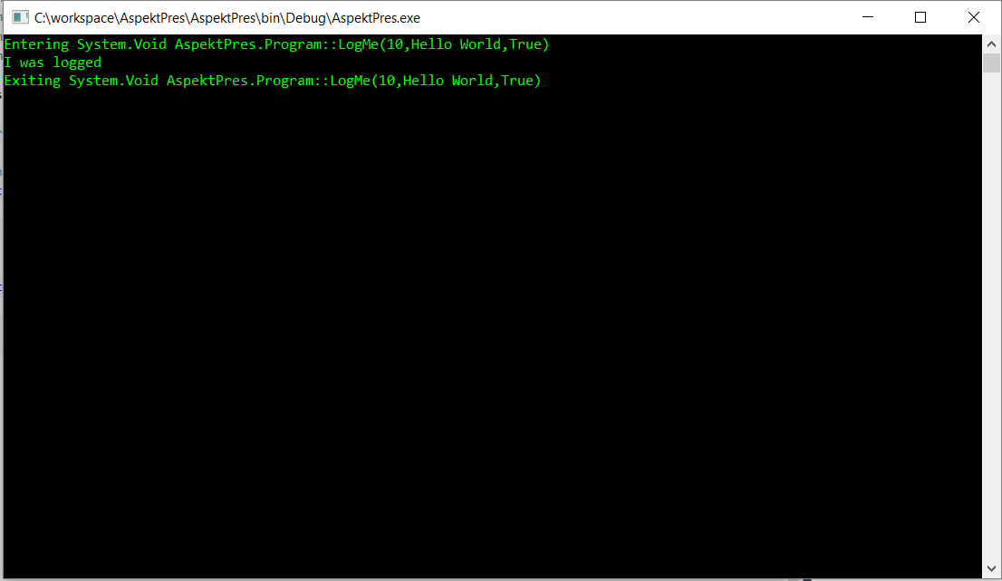

Slide 14
A case study
static class AccountManager
{
static List<Account> Accounts { get; } = new List<Account>();
public static void CreateAccount(string ownerName)
{
// No null checks
// No authentication
// No logging
Accounts.Add(new Account(ownerName));
}
}

Slide 15
Cont’d
static class AccountManager
{
static List<Account> Accounts { get; } = new List<Account>();
public static void CreateAccount(string ownerName)
{
if (ownerName == null)
throw new ArgumentNullException("ownerName");
Console.WriteLine($"Entered CreateAccount({ownerName})");
if (!AuthorizationManager.IsAuthorized(WindowsIdentity.GetCurrent(), Operation.Create | Operation.Account))
throw new NotAuthorizedException("CreateAccount");
Accounts.Add(new Account(ownerName));
Console.WriteLine("Exiting CreateAccount()");
}
}
Notes:
1 line of function and
6 lines of noise

Slide 16
Use Aspekt!
using Aspekt.Contracts; // For Null Checks
class IsAuthorized : Aspect
{
Operation Action { get; }
public IsAuthorized(Operation a)
{
Action = a;
}
public override void OnEntry(MethodArguments args)
{
if (!AuthorizationManager.IsAuthorized(WindowsIdentity.GetCurrent(), Action))
throw new NotAuthorizedException(args.MethodName);
}
}
class ConsoleLogged : Aspect
{
public override void OnEntry(MethodArguments args)
{
Console.WriteLine("Entered " + args.FormattedName);
}
public override void OnExit(MethodArguments args)
{
Console.WriteLine("Exiting " + args.FormattedName);
}
}

Slide 17
Cont’d
static class AccountManager
{
static List<Account> Accounts { get; } = new List<Account>();
[RequiresArgument("ownerName", typeof(string), Constraint.NotNull)]
[ConsoleLogged]
[IsAuthorized(Operation.Create | Operation.Account)]
public static void CreateAccountAspect(string ownerName)
{
Accounts.Add(new Account(ownerName));
}
}

Slide 18
Questions?
Thanks for listening.

